Slide 1

DA CAMBIARE
Predictive Aircraft Evaluation Using Statistical Learning

Slide 2

Analyzing the problem

Slide 3
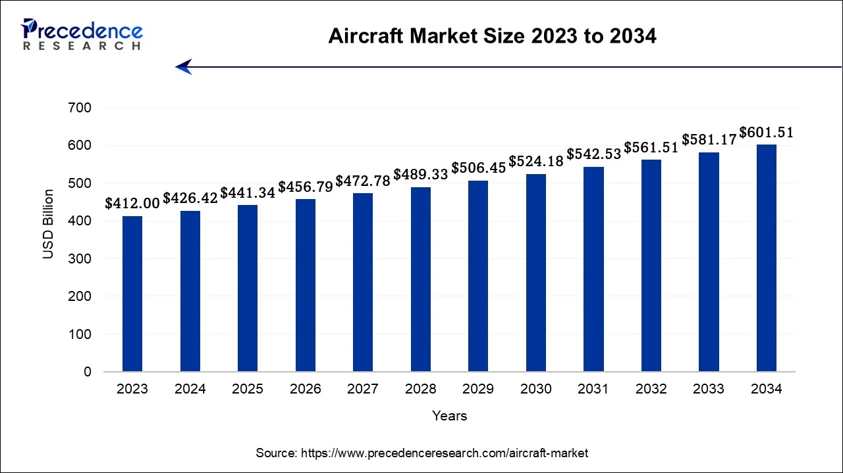
Aircraft as a growing market
The global aircraft market size was estimated at USD 426.42 billion in 2024 and is projected to hit around USD 601.51 billion by 2034

Slide 4
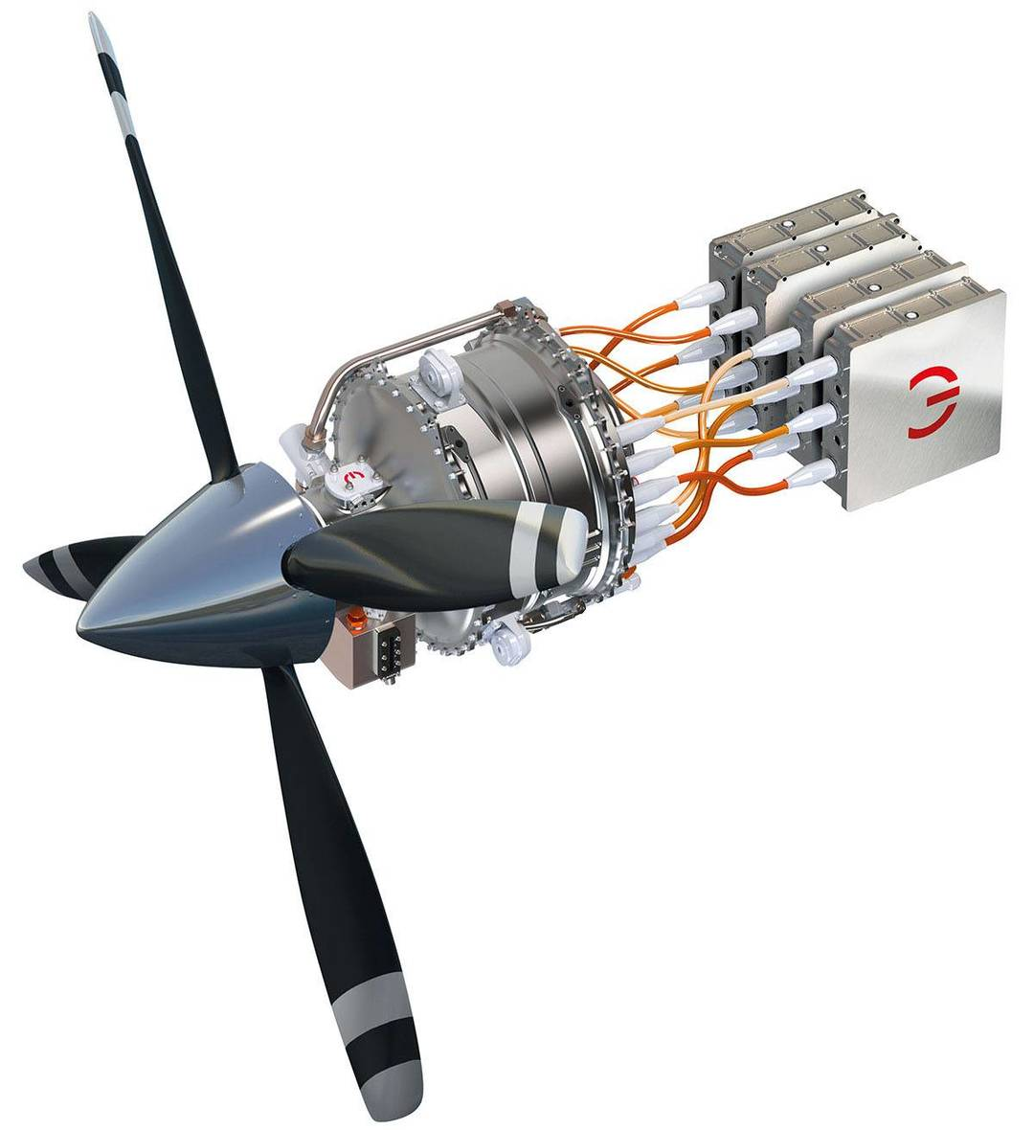

Aircraft as a Complex and Evolving Challenge
Technological innovation
(e.g. electric propulsion, lighter materials) makes traditional valuation methods less effective.
Market volatility
supply chain issues, and regulatory changes add further uncertainty.

Slide 5

Aircraft as a Complex and Evolving Challenge
Technological innovation
(e.g. electric propulsion, lighter materials) makes traditional valuation methods less effective.
Market volatility
supply chain issues, and regulatory changes add further uncertainty.
Traditional valuation
Aircraft appraisals are often slow, expensive, and subjective.

Slide 6

Aircraft as a Complex and Evolving Challenge
Technological innovation
(e.g. electric propulsion, lighter materials) makes traditional valuation methods less effective.
Market volatility
supply chain issues, and regulatory changes add further uncertainty.
Traditional valuation
Aircraft appraisals are often slow, expensive, and subjective.

Slide 7
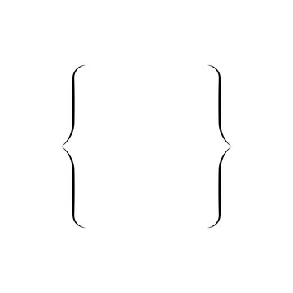

Aircraft as a Complex and Evolving Challenge
Technological innovation
(e.g. electric propulsion, lighter materials) makes traditional valuation methods less effective.
Making fast, data-driven valuation models
Market volatility
supply chain issues, and regulatory changes add further uncertainty.
Traditional valuation
Aircraft appraisals are often slow, expensive, and subjective.

Slide 8
Aircraft as a Complex and Evolving Challenge
“Traditional appraisals often require weeks and involve significant manual inspection, which is inefficient in fast-moving markets. Having a reliable data-based pricing model would be a game changer.”
Technological innovation
(e.g. electric propulsion, lighter materials) makes traditional valuation methods less effective.
Source: Interview published in Aviation Week
Market volatility
Making fast, data-driven valuation models
supply chain issues, and regulatory changes add further uncertainty.
Traditional valuation
Aircraft appraisals are often slow, expensive, and subjective.

Slide 9
Aircraft as a Complex and Evolving Challenge
“Traditional appraisals often require weeks and involve significant manual inspection, which is inefficient in fast-moving markets. Having a reliable data-based pricing model would be a game changer.”
Source: Interview published in Aviation Week
Making fast, data-driven valuation models

Slide 10

The dataset

Slide 11
QUI ELENCO TUTTE LE VAR E POI LE ALTRE SLIDE

Slide 12
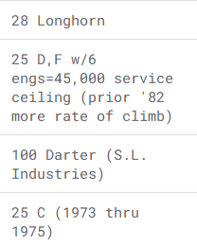
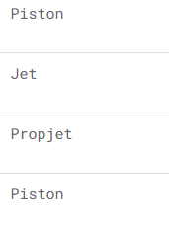
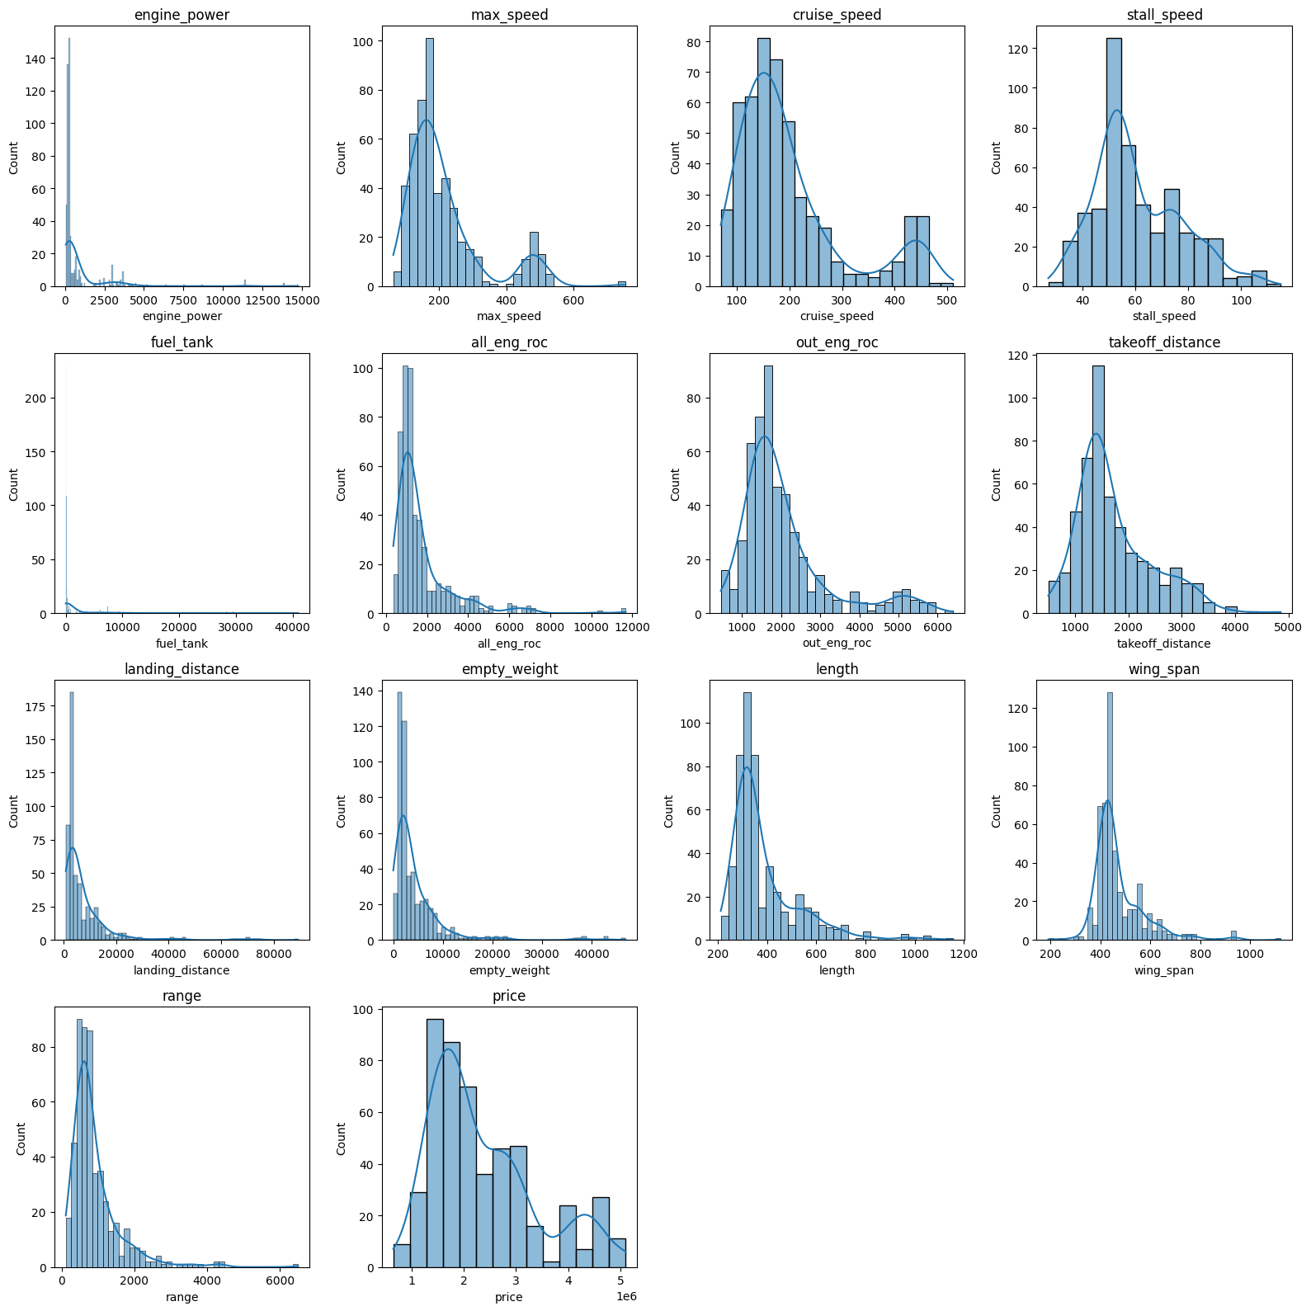
Categorical Variables
Exploring the Dataset:
model_name
engine_type:
Name of the aircraft model
Type of the engine.
Our dataset includes 14 numeric variables.

Slide 13
Numerical Variables
Exploring the Dataset:
engine_type:
model_name
Type of the engine.
Name of the aircraft model
Our dataset includes 14 numeric variables.

Slide 14
Numerical Variables
Exploring the Dataset:
engine_power
Power of the engine.
unit of measurement
HorsePower = 745.7 watts (W)

Slide 15
Numerical Variables
Exploring the Dataset:
max_speed
Maximum speed of the aircraft.
unit of measurement
Knots = 1.852 kilometers per hour (km/h)

Slide 16
Numerical Variables
Exploring the Dataset:
cruise_speed
Cruise speed of the aircraft.
unit of measurement
Knots = 1.852 kilometers per hour (km/h)

Slide 17
Numerical Variables
Exploring the Dataset:
Knots
stall_speed
Minimum speed of the aircraft to prevent stalling.
unit of measurement

Slide 18
Numerical Variables
Exploring the Dataset:
fuel_tank
Fuel tank capacity of the aircraft.
unit of measurement
Gallon = 3.785 liters (L)

Slide 19
Numerical Variables
Exploring the Dataset:
all_eng_roc
All Engine Rate of Climb. The maximum altitude of the aircraft at full power.
unit of measurement
Feet = 0.3048 meters (m)

Slide 20
Numerical Variables
Exploring the Dataset:
out_eng_roc
Out Engine Rate of Climb. The maximum altitude of the aircraft at out power.
unit of measurement
Feet = 0.3048 meters (m)

Slide 21
Numerical Variables
Exploring the Dataset:
takeoff_distance
The minimum distance required for an aircraft to take off.
unit of measurement
Feet = 0.3048 meters (m)

Slide 22
Numerical Variables
Exploring the Dataset:
landing_distance
The minimum distance required for an aircraft to landing.
unit of measurement
Feet = 0.3048 meters (m)

Slide 23
Numerical Variables
Exploring the Dataset:
empty_weight
Empty weight of the aircraft.
unit of measurement
Pound = 0.4536 kilograms (kg)

Slide 24
Numerical Variables
Exploring the Dataset:
length
Length of the aircraft.
unit of measurement
Inch = 2.54 centimeters (cm)

Slide 25
Numerical Variables
Exploring the Dataset:
wing_span
Wing span of the aircraft.
unit of measurement
Inch = 2.54 centimeters (cm)

Slide 26
Numerical Variables
Exploring the Dataset:
range
Range of the aircraft.
unit of measurement
Nautical mile = 1.852 kilometers (km)

Slide 27
Numerical Variables
Exploring the Dataset:
price
Price of the aircraft.
unit of measurement
USD dollars

Slide 28

Data preparation

Slide 29

Searching for missing data
A total of 10 missing values were found in the 'price' variable.
This represents a loss of approximately
1.93%
of the dataset's rows.
We decided to remove those rows.

Slide 30
Searching for missing data
A total of 10 missing values were found in the 'price' variable.
This represents a loss of approximately
1.93%
of the dataset's rows.
We decided to remove those rows.
This helps us identify highly correlated variables and ensure the reliability of our regression coefficients.

Slide 31
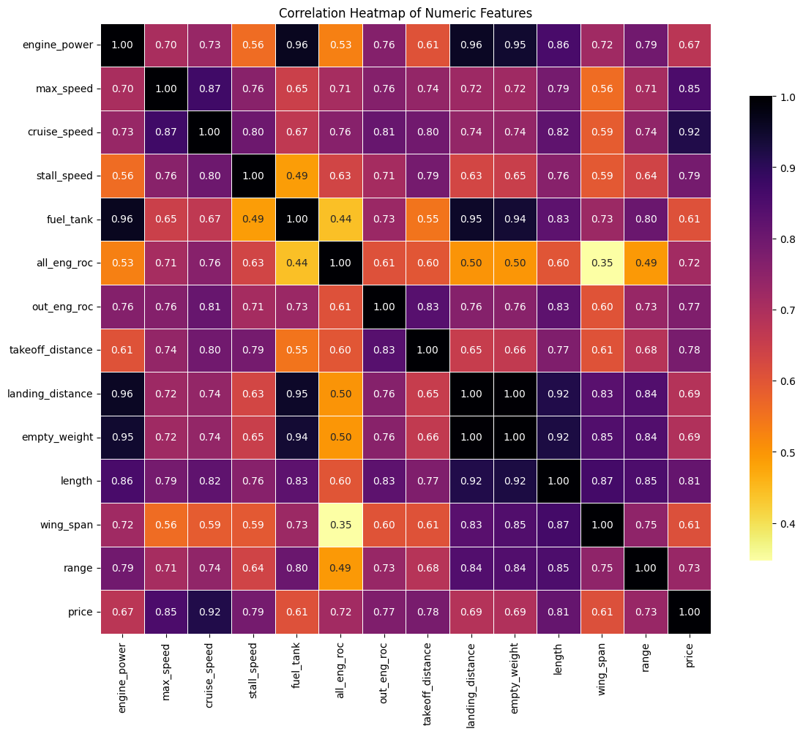
Correlation matrix
AGGIUNGI MINIMO

Slide 32
SCATTER PLOT DELLE ALTE CORRELATE
Devo vedere se non ci sono punti solo sulla bisettrice

Slide 33
SCATTER PLOT DELLE ALTE CORRELATE
Devo vedere se non ci sono punti solo sulla bisettrice

Slide 34
Calculating Variance Inflation Factor
Regressor | VIF
landing_distance | 172.36
empty_weight | 133.36
const | 94.26
fuel_tank | 27.04
engine_power | 24.51
length | 20.30
cruise_speed | 10.60
price | 8.62
Regressor | VIF
wing_span | 7.25
out_eng_roc | 6.51
max_speed | 5.30
takeoff_distance | 5.24
range | 4.65
stall_speed | 4.54
all_eng_roc | 2.71
This helps us identify highly correlated variables and ensure the reliability of our regression coefficients.

Slide 35
Calculating Variance Inflation Factor
Regressor | VIF
landing_distance | 172.36
empty_weight | 133.36
const | 94.26
fuel_tank | 27.04
engine_power | 24.51
length | 20.30
cruise_speed | 10.60
price | 8.62
Regressor | VIF
wing_span | 7.25
out_eng_roc | 6.51
max_speed | 5.30
takeoff_distance | 5.24
range | 4.65
stall_speed | 4.54
all_eng_roc | 2.71
This helps us identify highly correlated variables and ensure the reliability of our regression coefficients.

Slide 36
Calculating the Skewness
Regressor | Skewness
fuel_tank | 5.04
engine_power | 4.69
landing_distance | 4.29
empty_weight | 4.19
all_eng_roc | 3.00
range | 2.94
wing_span | 2.19
Regressor | Skewness
length | 2.10
out_eng_roc | 1.74
max_speed | 1.69
cruise_speed | 1.37
takeoff_distance | 1.05
price | 0.94
stall_speed | 0.70
We evaluate the symmetry of the numerical variable distributions. This helps us detect potential distortions that might affect model performance…
… And decided to apply a log transformation to all variables with skewness greater than 1.

Slide 37
Calculating the Skewness
Regressor | Skewness
fuel_tank | 5.04
engine_power | 4.69
landing_distance | 4.29
empty_weight | 4.19
all_eng_roc | 3.00
range | 2.94
wing_span | 2.19
Regressor | Skewness
length | 2.10
out_eng_roc | 1.74
max_speed | 1.69
cruise_speed | 1.37
takeoff_distance | 1.05
price | 0.94
stall_speed | 0.70
We evaluate the symmetry of the numerical variable distributions. This helps us detect potential distortions that might affect model performance…
… And decided to apply a log transformation to all variables with skewness greater than 1.

Slide 38
Overall results

Slide 39
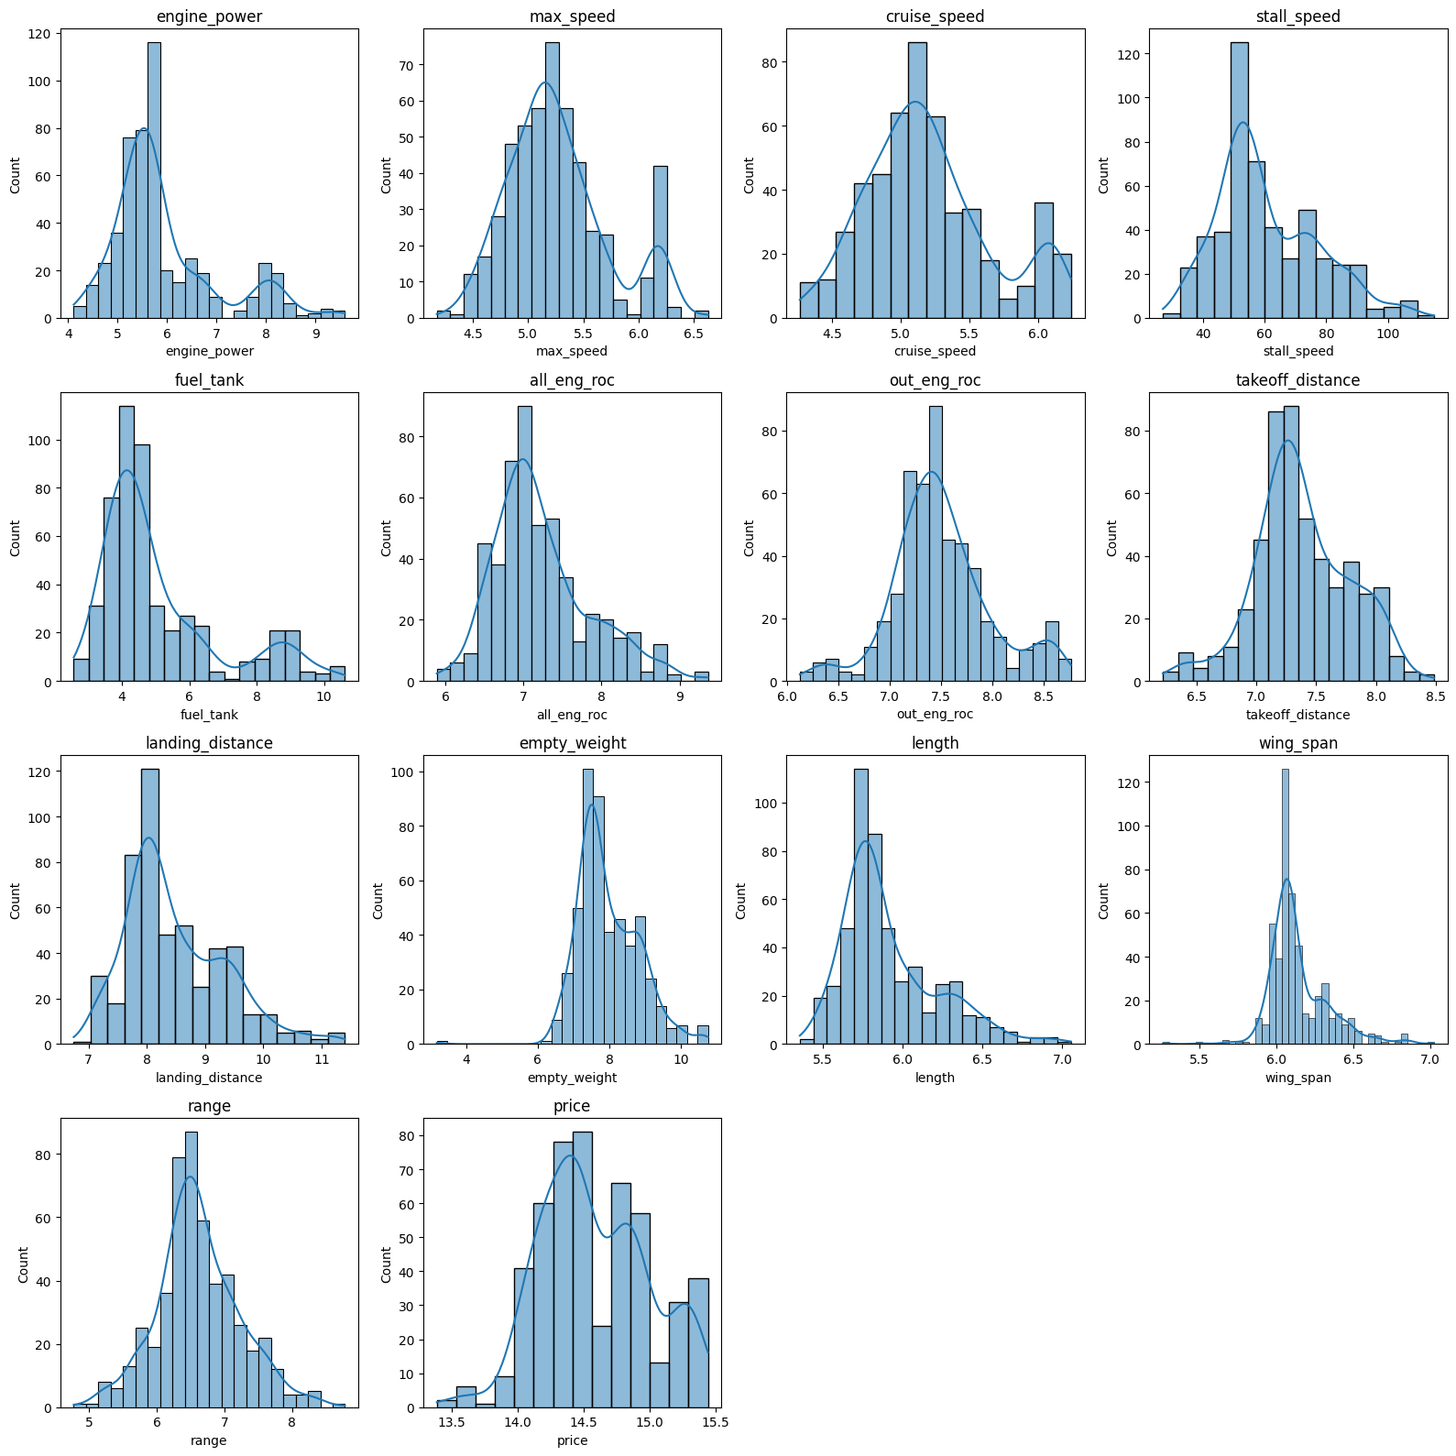
Overall results

Slide 40
Some results
Original
Log-Transformed

Slide 41
Some results
Original
Log-Transformed

Slide 42
Some results
Original
Log-Transformed

Slide 43
Some results
TARGET
Original
Log-Transformed

Slide 44
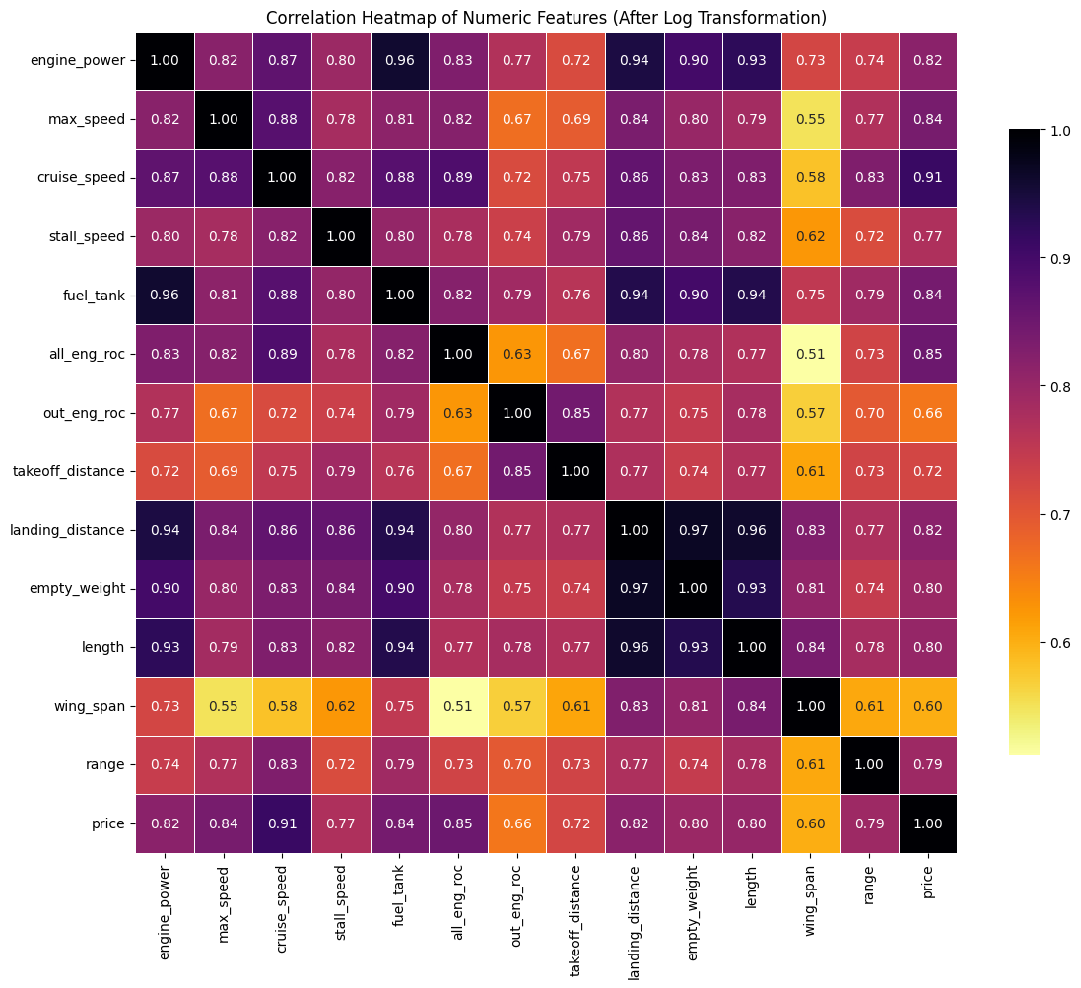
Correlation matrix

Slide 45
Old vs New Variance Inflation Factor
Regressor | VIF
landing_distance | 172.36
empty_weight | 133.36
const | 94.26
fuel_tank | 27.04
engine_power | 24.51
length | 20.30
cruise_speed | 10.60
price | 8.62
Regressor | VIF
wing_span | 7.25
out_eng_roc | 6.51
max_speed | 5.30
takeoff_distance | 5.24
range | 4.65
stall_speed | 4.54
all_eng_roc | 2.71
This helps us identify highly correlated variables and ensure the reliability of our regression coefficients.

Slide 46
Old vs New Variance Inflation Factor
Regressor | VIF
landing_distance | 172.36
empty_weight | 133.36
const | 94.26
fuel_tank | 27.04
engine_power | 24.51
length | 20.30
cruise_speed | 10.60
price | 8.62
Regressor | VIF
wing_span | 7.25
out_eng_roc | 6.51
max_speed | 5.30
takeoff_distance | 5.24
range | 4.65
stall_speed | 4.54
all_eng_roc | 2.71
This helps us identify highly correlated variables and ensure the reliability of our regression coefficients.

Slide 47
Old vs New Variance Inflation Factor
Regressor | VIF Variation
landing_distance | - 117.53
empty_weight | - 116.17
const | - 74.99
fuel_tank | - 8.21
engine_power | - 2.82
length | - 1.03
cruise_speed | + 2.22
price | - 1.22
Regressor | VIF Variation
wing_span | - 0.92
out_eng_roc | - 1.28
max_speed | + 0.45
takeoff_distance | + 0.11
range | - 0.51
stall_speed | + 1.01
all_eng_roc | + 3.33
This helps us identify highly correlated variables and ensure the reliability of our regression coefficients.

Slide 48
Old vs New Variance Inflation Factor
Regressor | VIF
landing_distance | 54.83
empty_weight | 17.19
const | 19.27
fuel_tank | 18.83
engine_power | 21.69
length | 19.27
cruise_speed | 12.82
price | 7.40
Regressor | VIF
wing_span | 6.33
out_eng_roc | 5.23
max_speed | 5.75
takeoff_distance | 5.35
range | 4.14
stall_speed | 5.53
all_eng_roc | 6.04
This helps us identify highly correlated variables and ensure the reliability of our regression coefficients.

Slide 49
Not enough

Slide 50
Feature engineering
To address high VIF values,
we implemented an iterative procedure that removes one variable at a time based on the highest VIF score. At each step, the VIF is recalculated until all remaining variables have a VIF below a defined threshold of 10. This approach helps reduce multicollinearity while preserving the most relevant features.

Slide 51
Feature engineering
Regressor | VIF
landing_distance | 54.83
empty_weight | 17.19
const | 19.27
fuel_tank | 18.83
engine_power | 21.69
length | 19.27
cruise_speed | 12.82
price | 7.40
Regressor | VIF
wing_span | 6.33
out_eng_roc | 5.23
max_speed | 5.75
takeoff_distance | 5.35
range | 4.14
stall_speed | 5.53
all_eng_roc | 6.04

Slide 52
Feature engineering
Regressor | VIF
landing_distance | 54.83
empty_weight | 17.19
const | 19.27
fuel_tank | 18.83
engine_power | 21.69
length | 19.27
cruise_speed | 12.82
price | 7.40
Regressor | VIF
wing_span | 6.33
out_eng_roc | 5.23
max_speed | 5.75
takeoff_distance | 5.35
range | 4.14
stall_speed | 5.53
all_eng_roc | 6.04

Slide 53
Feature engineering
Regressor | VIF
const | 6462.81
engine_power | 7.88
price | 5.74
all_eng_roc | 5.64
takeoff_distance | 5.19
Regressor | VIF
out_eng_roc | 4.90
max_speed | 4.89
stall_speed | 4.34
range | 3.52
wing_span | 2.65

Slide 54
Feature engineering
Regressor | VIF
const | 6462.81
engine_power | 7.88
price | 5.74
all_eng_roc | 5.64
takeoff_distance | 5.19
Regressor | VIF
out_eng_roc | 4.90
max_speed | 4.89
stall_speed | 4.34
range | 3.52
wing_span | 2.65

Slide 55
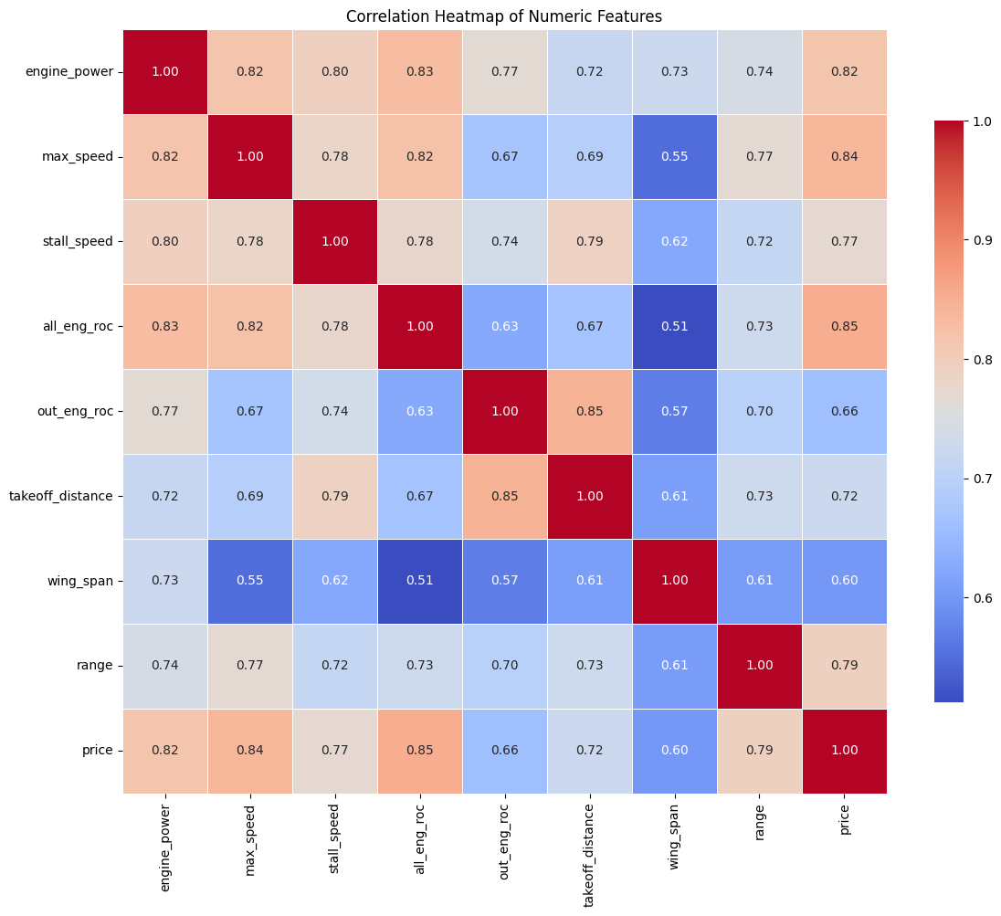
Correlation matrix

Slide 56
Feature engineering
Regressor | VIF
const | 6462.81
engine_power | 7.88
price | 5.74
all_eng_roc | 5.64
takeoff_distance | 5.19
Regressor | VIF
out_eng_roc | 4.90
max_speed | 4.89
stall_speed | 4.34
range | 3.52
wing_span | 2.65

Slide 57
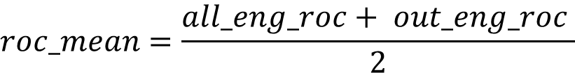
Feature engineering
Regressor | VIF
const | 6462.81
engine_power | 7.88
price | 5.74
all_eng_roc | 5.64
takeoff_distance | 5.19
Regressor | VIF
out_eng_roc | 4.90
max_speed | 4.89
stall_speed | 4.34
range | 3.52
wing_span | 2.65
$$roc_mean=\frac{all_eng_roc+ out_eng_roc }{2}$$

Slide 58
Feature engineering
Regressor | VIF
const | 6462.81
engine_power | 7.88
price | 5.74
all_eng_roc | 5.64
takeoff_distance | 5.19
Regressor | VIF
out_eng_roc | 4.90
max_speed | 4.89
stall_speed | 4.34
range | 3.52
wing_span | 2.65
$$speed_margin=max_speed− stall_speed$$

Slide 59
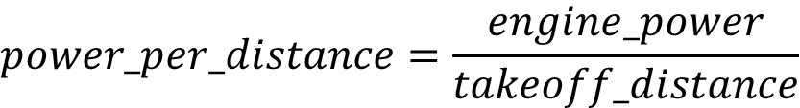
Feature engineering
Regressor | VIF
const | 6462.81
engine_power | 7.88
price | 5.74
all_eng_roc | 5.64
takeoff_distance | 5.19
Regressor | VIF
out_eng_roc | 4.90
max_speed | 4.89
stall_speed | 4.34
range | 3.52
wing_span | 2.65
$$power_per_distance=\frac{engine_power}{takeoff_distance}$$

Slide 60
Result
Regressor | VIF
const | 2327.79
roc_mean | 5.88
speed_margin | 3.63
power_per_distance | 3.14
wing_span | 2.12
range | 2.90

Slide 61
Result
Regressor | VIF
const | 2327.79
roc_mean | 5.88
speed_margin | 3.63
power_per_distance | 3.14
wing_span | 2.12
range | 2.90

Slide 62
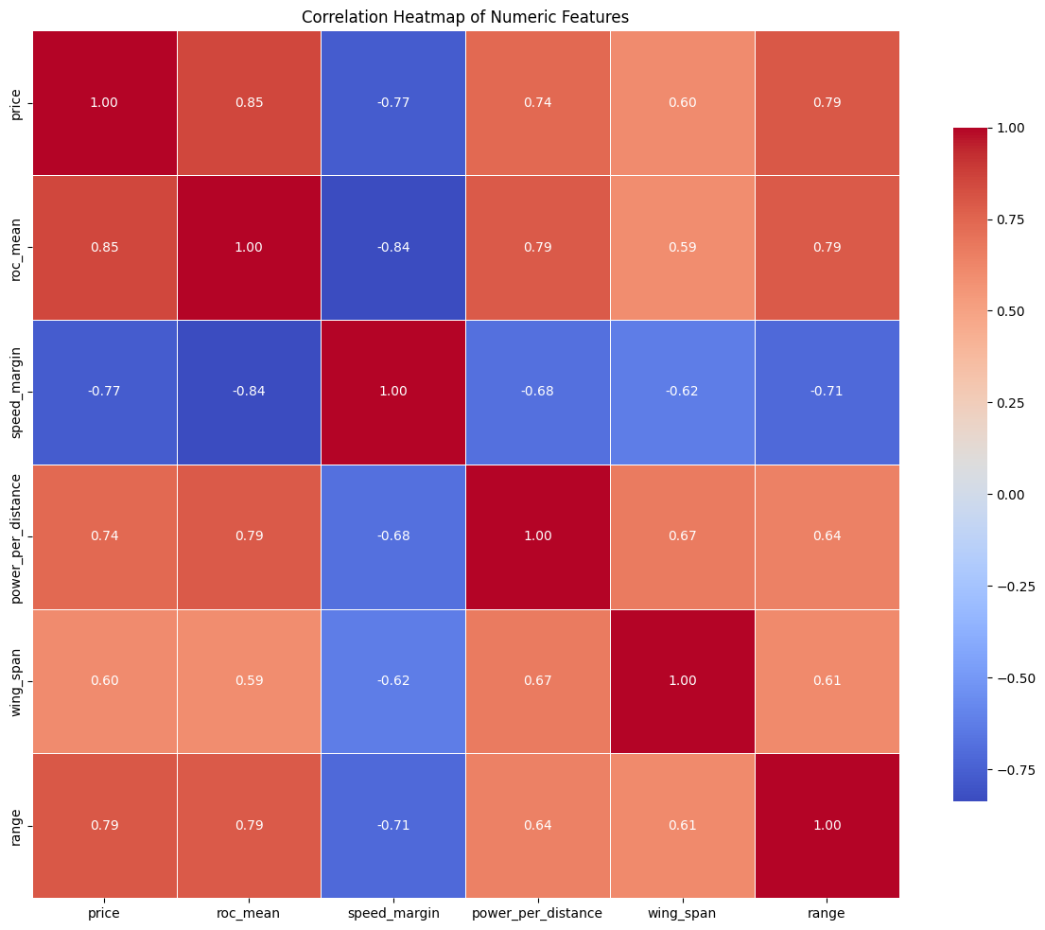
Correlation matrix

Slide 63
But what if we hadn’t log-transformed

Slide 64
Correlation matrix
OLD

Slide 65
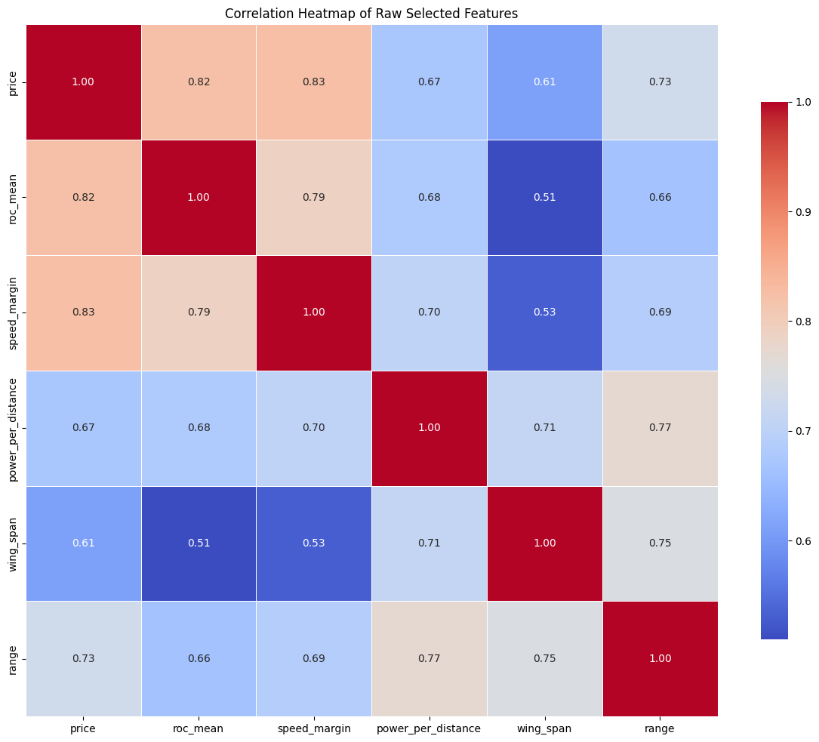
Correlation matrix
NEW

Slide 66
What about the VIF
Regressor | VIF
const | 2327.79
roc_mean | 5.88
speed_margin | 3.63
power_per_distance | 3.14
wing_span | 2.12
range | 2.90
Regressor | VIF
const | 42.8
roc_mean | 3.77
speed_margin | 3.95
power_per_distance | 3.41
wing_span | 2.68
range | 3.67
OLD
NEW

Slide 67
And what if we now log transform only the target?

Slide 68
Correlation matrix
OLD

Slide 69
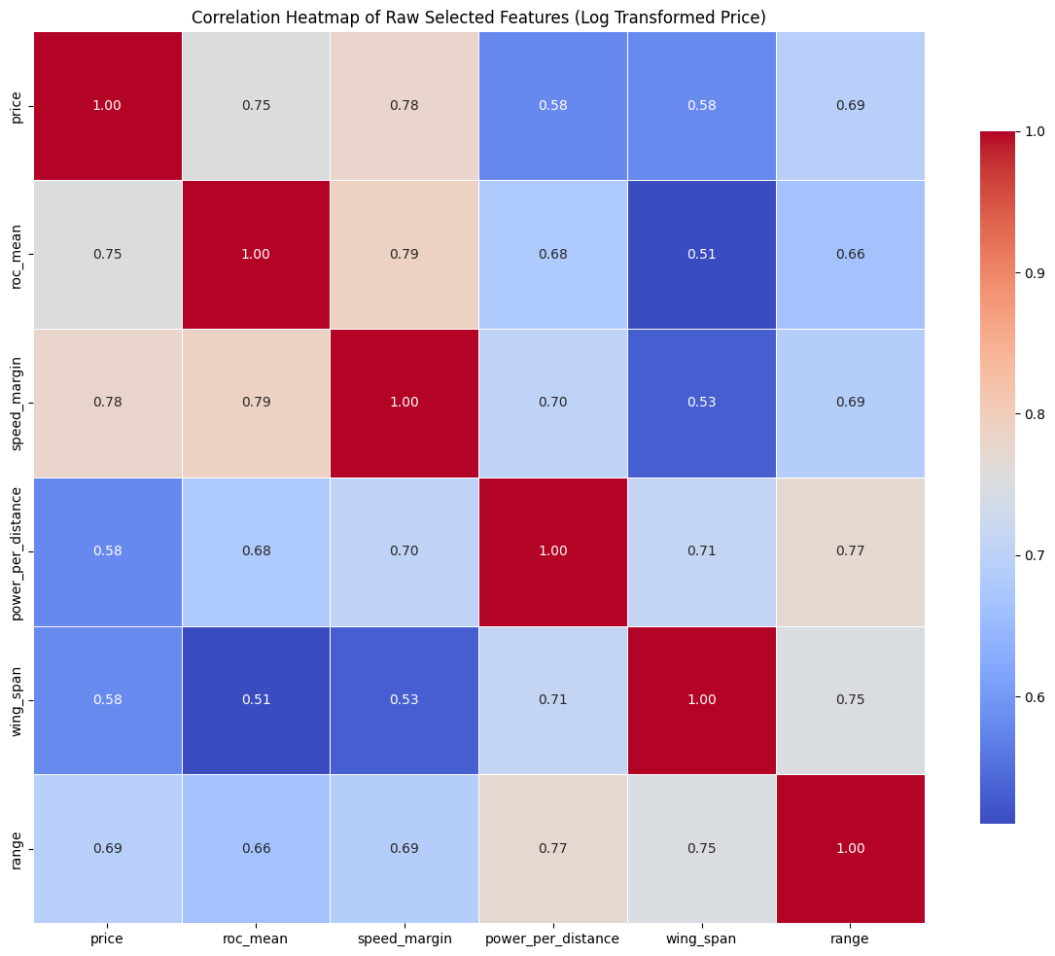
Correlation matrix
NEW

Slide 70
What about the VIF
Regressor | VIF
const | 42.8
roc_mean | 3.77
speed_margin | 3.95
power_per_distance | 3.41
wing_span | 2.68
range | 3.67
Regressor | VIF
const | 3885.36
roc_mean | 3.37
speed_margin | 3.90
power_per_distance | 3.63
wing_span | 2.71
range | 3.70
OLD
NEW

Slide 71
We decided that applying a log transformation only to the target variable results in the best model

Slide 72
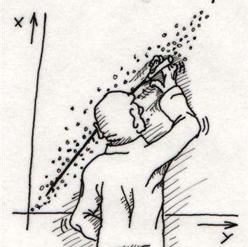
Linear Regression

Slide 73

$$Togli la singola e metti solo la multivariata$$
Choosing the regressor:
We developed a piece of code that allowed us to identify the most promising numerical variables for predicting the price, selecting those with the lowest p-values and a good coefficient of determination (R²).

Slide 74
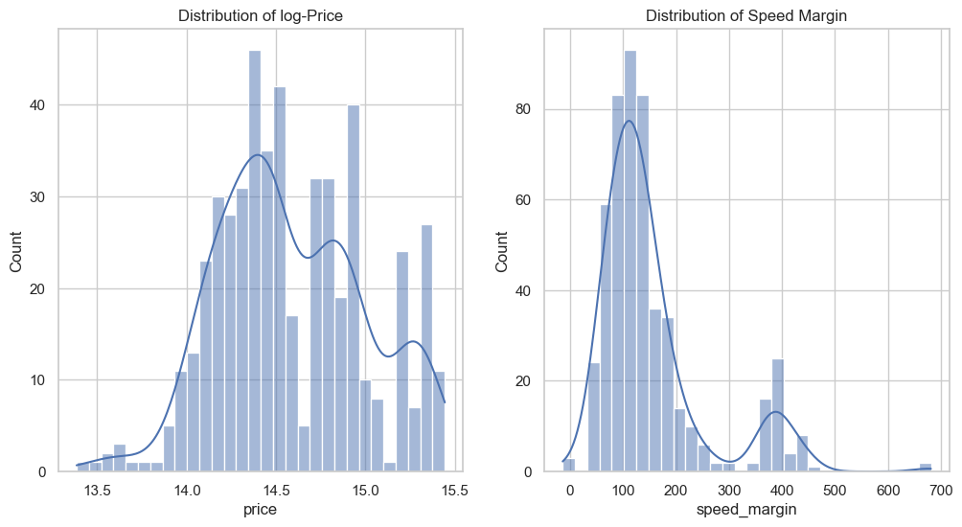

$y=β_{0}+β_{1}×speed_margin+e$
Choosing the regressor:
Log-Value
7
7,5
8
8,5

Slide 75
$y=β_{0}+β_{1}×speed_margin+e$
Prediction:
Log-Value
70
100
150
200

Slide 76
$y=β_{0}+β_{1}×speed_margin+e$
Prediction:
Log-Value | Log-Value Prediction
70 | 14.33 (± 0.029)
100 | 14.42 (± 0.025)
150 | 14.58 (± 0.022)
200 | 14.73 (± 0.025)

Slide 77
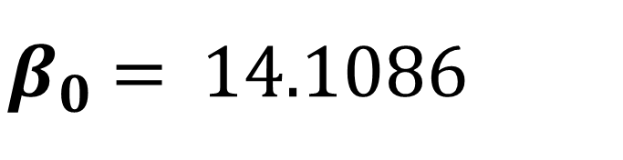
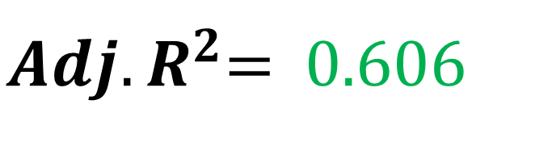
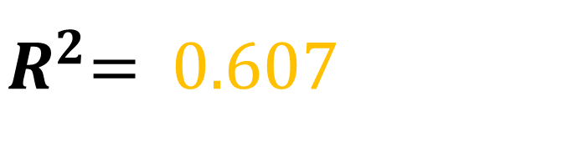
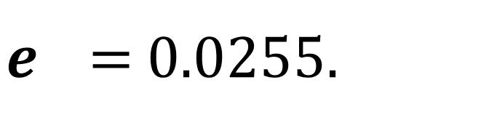
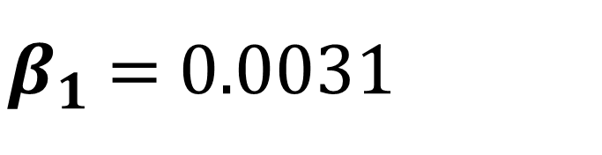
$y=β_{0}+β_{1}×speed_margin+e$
Prediction:
x | Log(Y) | y
70 | 14.33 (± 0.029) | 1 672 784.23
100 | 14.42 (± 0.025) | 1 830 317.48
150 | 14.58 (± 0.022) | 2 147 897.46
200 | 14.73 (± 0.025) | 2 495 500.82
$β_{0}$ = 14.1086
$R^{2}$= 0.607
$β_{1}$ = 0.0031
${Adj. R}^{2}$= 0.606
$e$ = 0.0255.

Slide 78

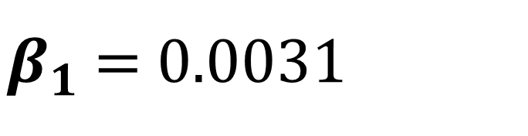
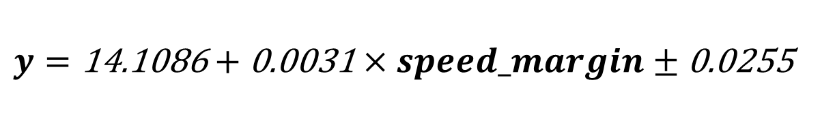
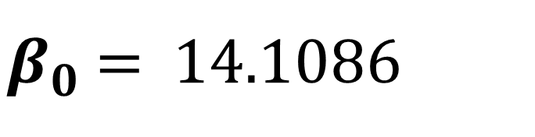
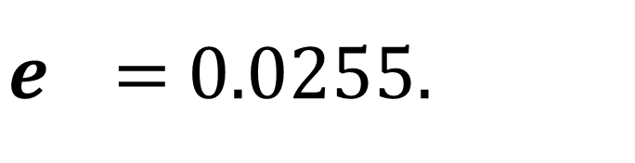

$y=β_{0}+β_{1}×speed_margin+e$
Formula:
Log-Value | Log-Value Prediction | Prediction
70 | 14.33 (± 0.029) | 1 672 784.23
100 | 14.42 (± 0.025) | 1 830 317.48
150 | 14.58 (± 0.022) | 2 147 897.46
200 | 14.73 (± 0.025) | 2 495 500.82
$β_{0}$ = 14.1086
$R^{2}$= 0.607
$$y=\text{14.1086}+\text{0.0031}×speed_margin±\text{0.0255}$$
$β_{1}$ = 0.0031
${Adj. R}^{2}$= 0.606
$e$ = 0.0255.
RMSE = 724 769

Slide 79
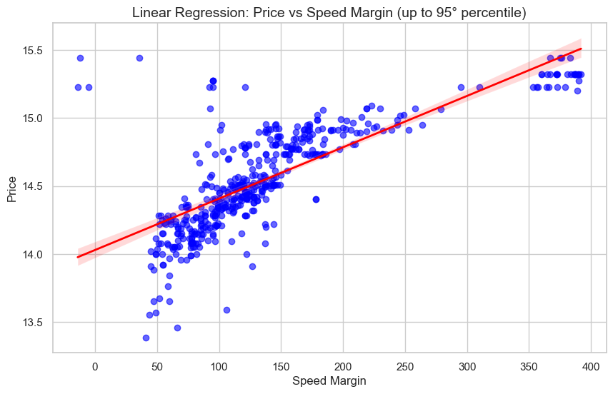
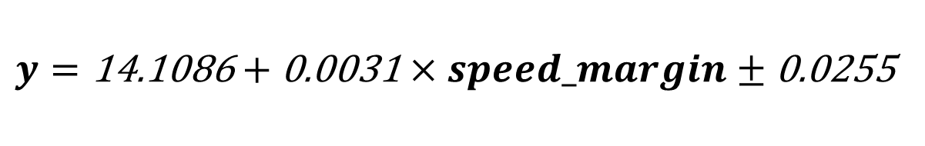
$y=β_{0}+β_{1}×speed_margin+e$
Formula:
$β_{0}$ = 14.1086
$$y=\text{14.1086}+\text{0.0031}×speed_margin±\text{0.0255}$$
$β_{1}$ = 0.0031
$e$ = 0.0255.

Slide 80
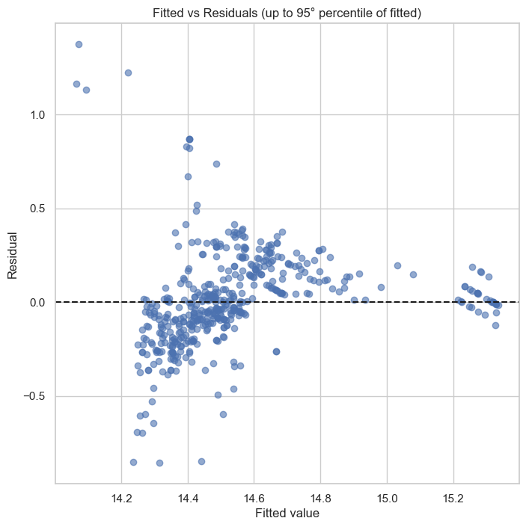
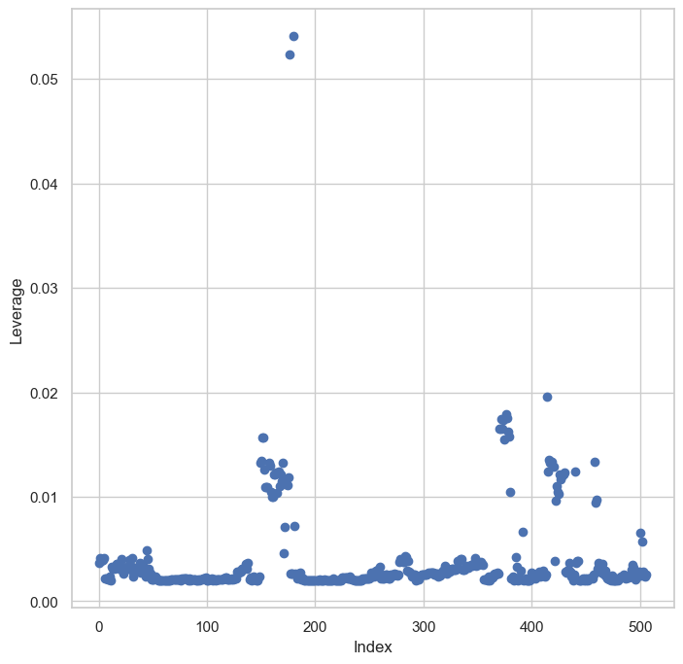
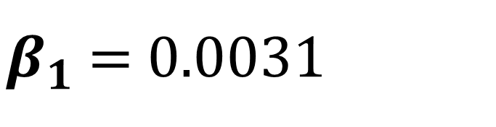

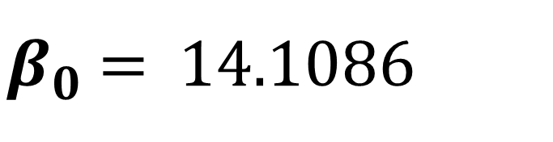
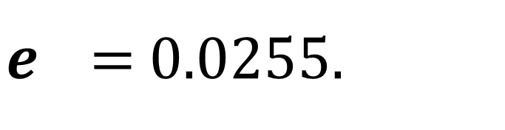
$$y=\text{14.1086}+\text{0.0031}×speed_margin±\text{0.0255}$$
Plots:
$β_{0}$ = 14.1086
$β_{1}$ = 0.0031
$e$ = 0.0255.

Slide 81
Plots:
$$y=\text{9.3492}+\text{0.7114}×roc_mean±\text{0.0305}$$

Slide 82
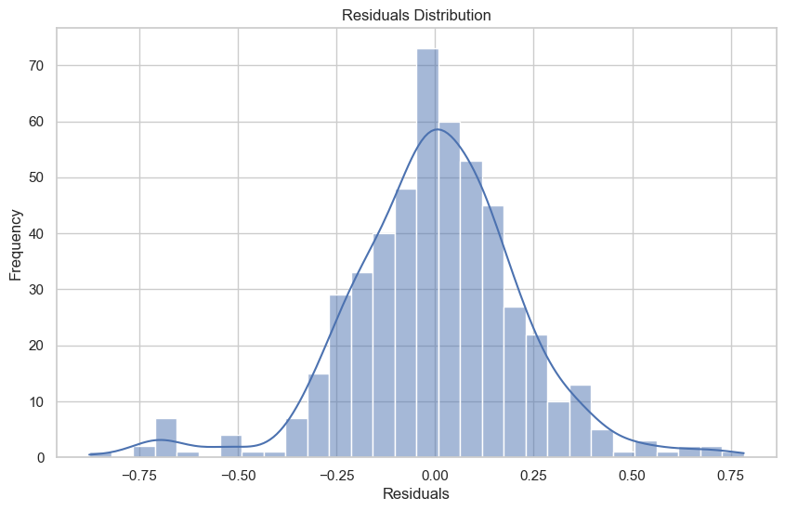

$Multiple Linear Regression$
Using all the regressors:
Variable | P-value
roc_mean
speed_margin
power_per_distance
wing_span
range

Slide 83
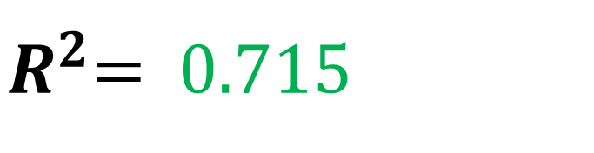
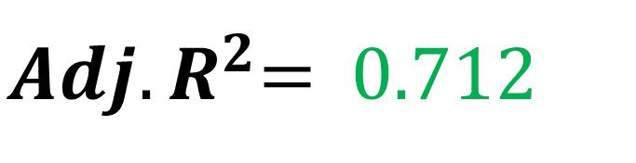
$Multiple Linear Regression$
Using all the regressors:
$R^{2}$= 0.715
${Adj. R}^{2}$= 0.712
RMSE= 523 060

Slide 84
$Multiple Linear Regression$
Plots:
Variable | P-value
roc_mean
speed_margin
power_per_distance
wing_span
range

Slide 85
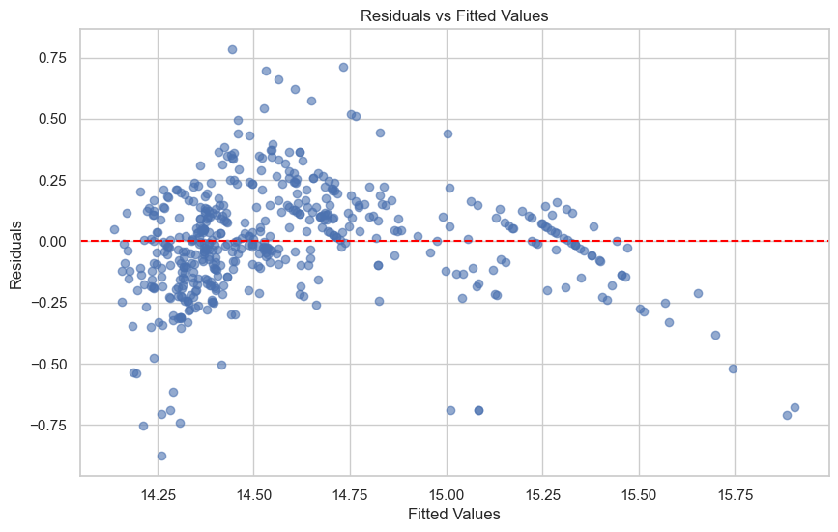
$Multiple Linear Regression$
Plots:

Slide 86
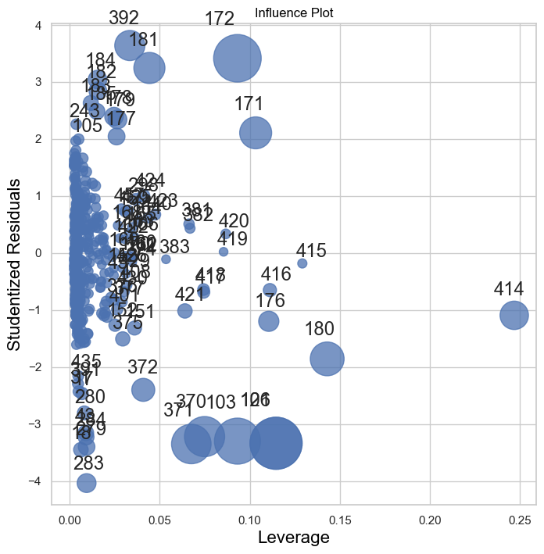
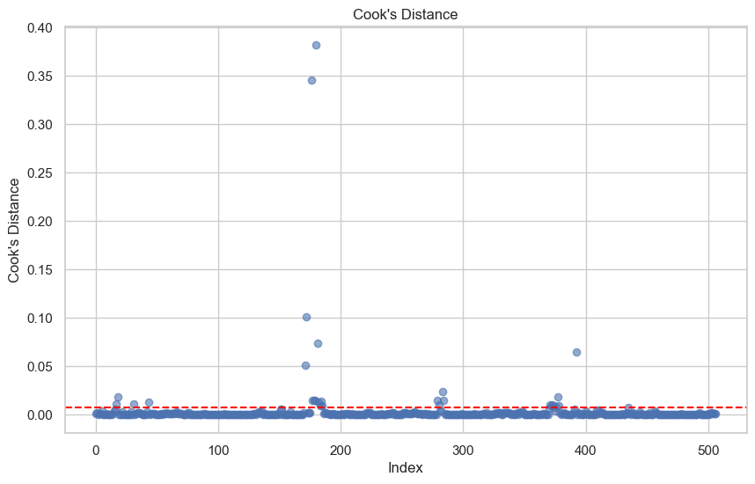
$Multiple Linear Regression$
Plots:

Slide 87
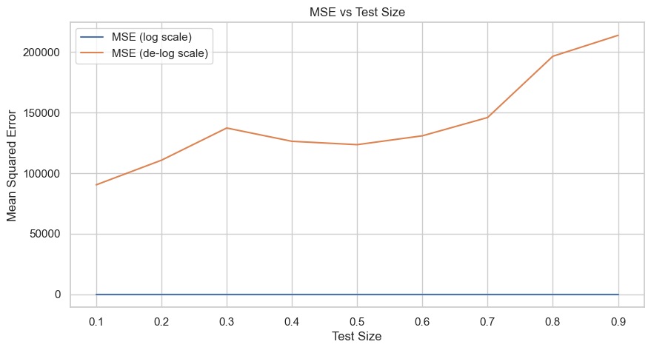
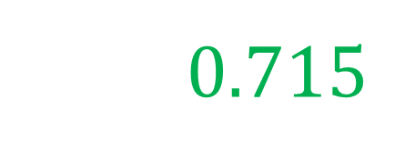

$80−20 Cross Validation$
$R^{2}$= 0.715

Slide 88
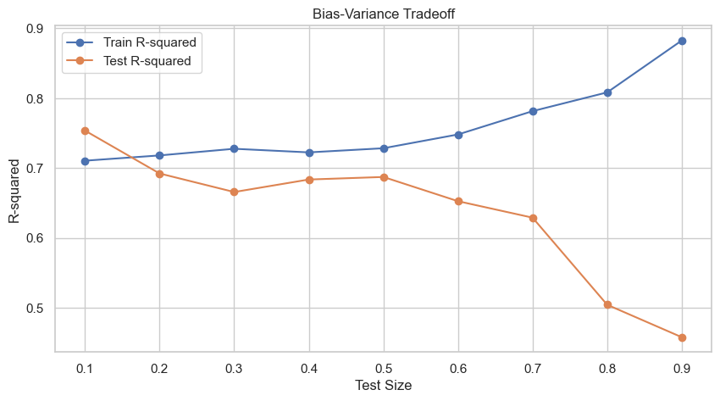

$80 −20 Cross Validation$
$R^{2}$= 0.715

Slide 89
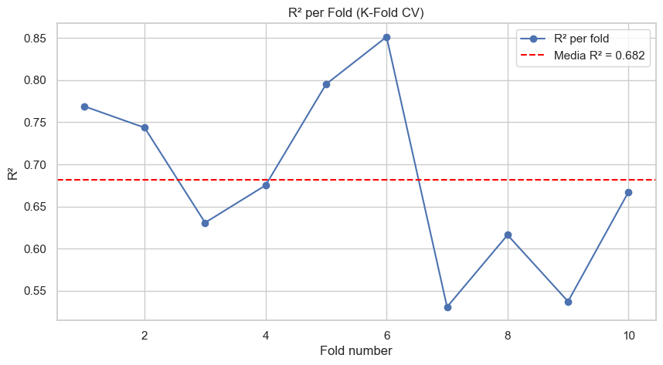
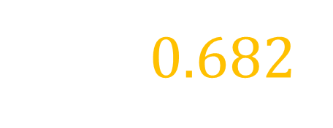

$K−Fold Cross Validation$
$R^{2}$= 0.682

Slide 90
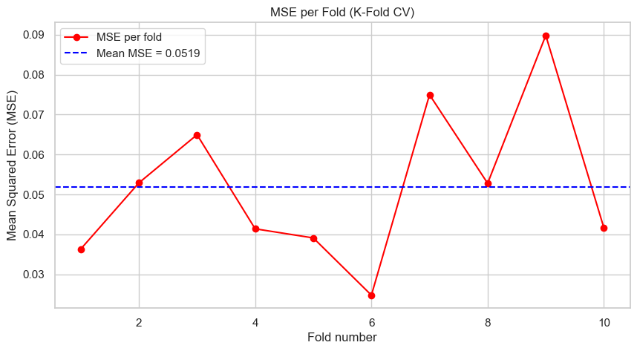
$K−Fold Cross Validation$
$R^{2}$= 0.682

Slide 91
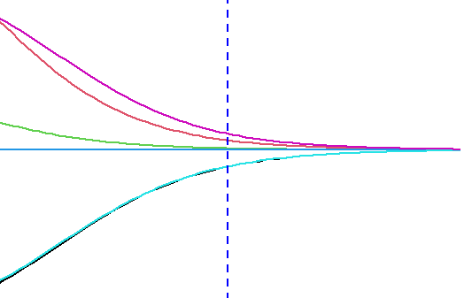
Ridge & Lasso

Slide 92
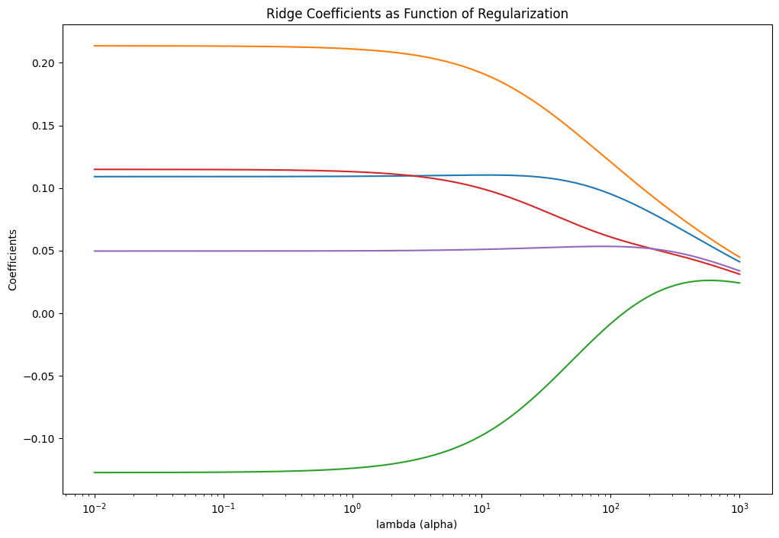

$$Ridge$$

Slide 93
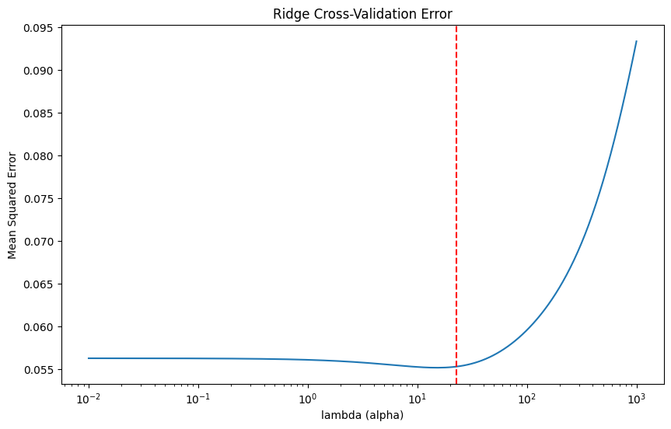
$$Ridge$$

Slide 94
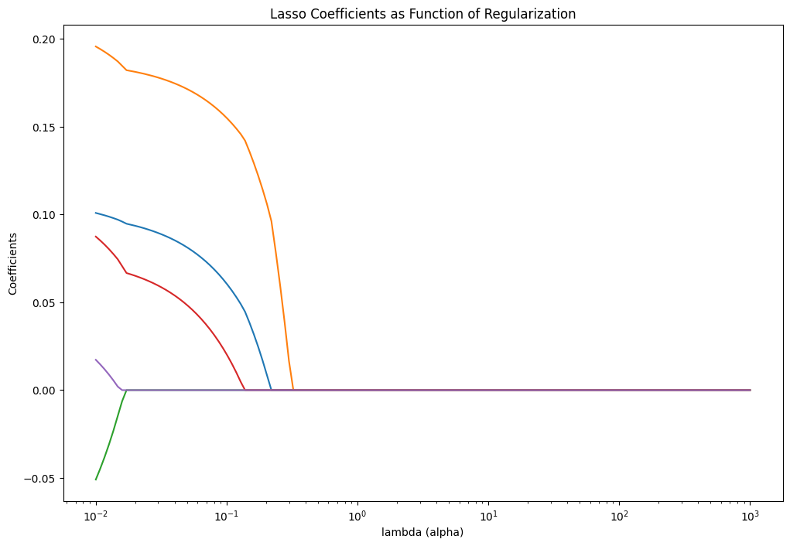

$$Lasso$$

Slide 95
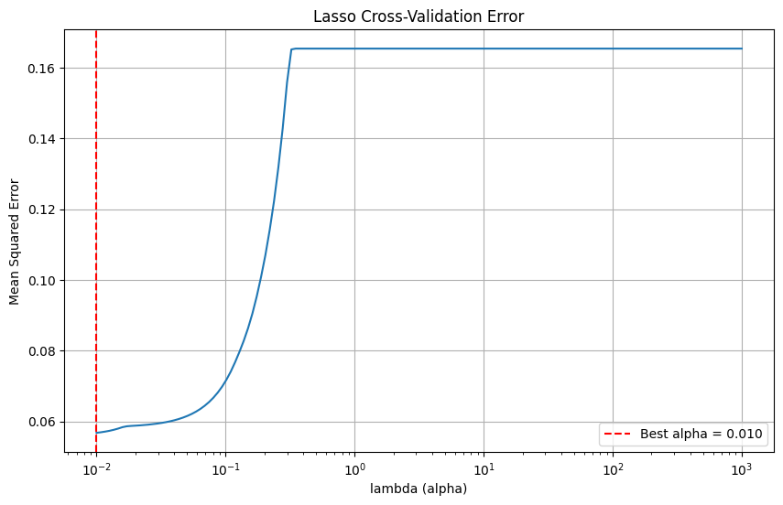
$$Lasso$$

Slide 96
Non Linear Models

Slide 97

Smoothing Spline for Range
RMSE= 604’ 841 $
Effect of increasing λ: the curve’s curvature progressively decreases, shifting from “noisy” detail to a smoother, almost linear trend.
Grid-search (black line): automatically picks the λ that best trades off bias and variance on validation data.

Slide 98

Smoothing Spline for Speed Margin
RMSE= 462’ 643 $
(In simple Linear Regression we had RMSE = 724 769 )
Effect of increasing λ: the curve’s curvature progressively decreases, shifting from “noisy” detail to a smoother, almost linear trend.
Grid-search (black line): automatically picks the λ that best trades off bias and variance on validation data.

Slide 99

Smoothing Spline for roc_mean
RMSE= 442’073 $
Effect of increasing λ: the curve’s curvature progressively decreases, shifting from “noisy” detail to a smoother, almost linear trend.
Grid-search (black line): automatically picks the λ that best trades off bias and variance on validation data.

Slide 100

Smoothing Spline for power per distance
RMSE= 606’ 452 $
Effect of increasing λ: the curve’s curvature progressively decreases, shifting from “noisy” detail to a smoother, almost linear trend.
Grid-search (brown line): automatically picks the λ that best trades off bias and variance on validation data.

Slide 101

Smoothing Spline for wing span
RMSE= 784’ 468 $
Effect of increasing λ: the curve’s curvature progressively decreases, shifting from “noisy” detail to a smoother, almost linear trend.
Grid-search (brown line): automatically picks the λ that best trades off bias and variance on validation data.

Slide 102
GAMs
Regressor | Pvalue | edf
roc_mean | 3.09 × 10⁻⁴ | 9.6
speed_margin | 1.11 × 10⁻¹⁶ | 7.5
power_per_distance | 3.04 × 10⁻⁵ | 4.8
wing_span | 1.05 × 10⁻³ | 5.3
range | 7.26 × 10⁻⁵ | 10.4
Pseudo R²: 0.858
RMSE= 332’ 326 $

Slide 103



GAMs

Slide 104


GAMs
Centered, symmetric residuals: residuals cluster tightly around zero with no heavy tails
No pattern in residuals vs. fitted: absence of systematic structure suggests homoscedasticity

Slide 105
Tree Based Models
DA METTERE PiU LEGGIBILE MA A STO PUNTO NON TORNO AL DATASET DI PARTENZA, TENGO QUELLO SOPRA We use the original features from aircraft_price dataset now

Slide 106

Regression Decision Tree
Not Pruned Tree

Slide 107

Decision Tree
Pruned Tree

Slide 108

Tree models
Comparison

Slide 109

Tree models
Comparison

